Slide 1

Moses Adriko
Bilharzia and Worm Control, Uganda
Ministry of Health, Uganda

Slide 2
PRESENTATION OUTLINE
Background/Geographic al location of Vector Control Division, Uganda.
Long term scientific goals of Vector Control Division, Uganda.
Main research questions of Vector Control Division, Uganda.
Main research question of your project (be it at any level, from cloning a gene, identifying how drug resistance spread to epidemiology)
Unique skills or expertise that someone else might benefit from.
Collaboration skill/resources that someone else might have will promote your project.
Difficulties do you face in doing research in your local area?

Slide 3
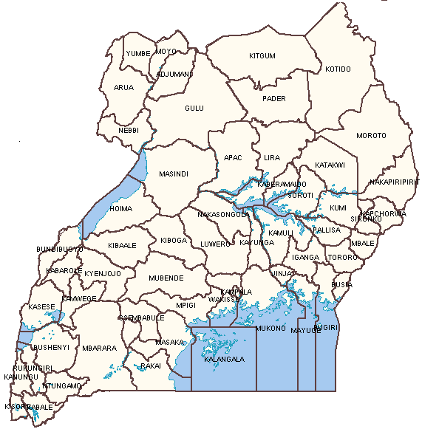
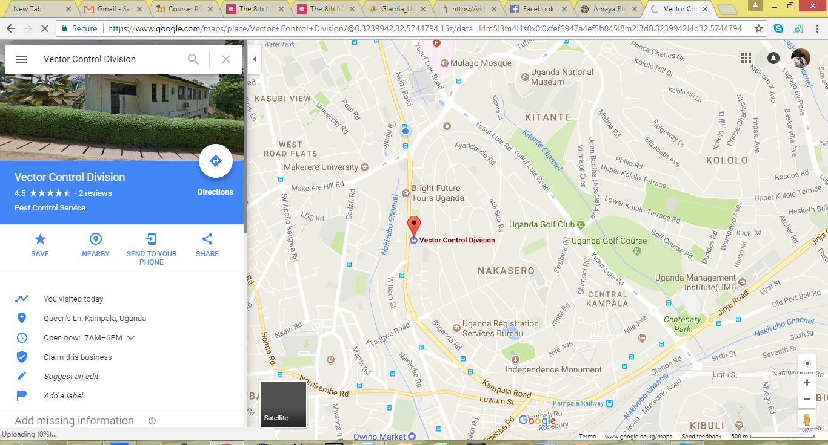
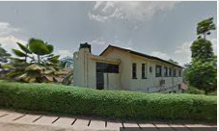
UGANDA COUNTRY PROFILE
East African
240,000 km² in area
18% open water
2006 had 56 districts
2017 - 116 districts
Most services decentralised esp. Local Govt.
NEW SUDAN
DRC
KENYA
TANZANIA
BURUNDI RWANDA

Slide 4
BACKGROUND OF VECTOR CONTROL DIVISION
Started in 1901 with emphasis on malaria transmission & vector control especially in urban areas and other communicable diseases.
Vector Control Division involved in diverse disease control / elimination programmes activities throughout the country:
Bilharzia and Worm Control Programme(BWCP)
National Sleeping Sickness Control Programme (HAT)
Programme to Eliminate Lymphatic Filariasis (PELF)
National Onchocerciasis Control Programme (NOCP)
Other activities include :
Epidemiology/Risk factors for Leishmaniasis
General vector / pest control activities / consultations

Slide 5
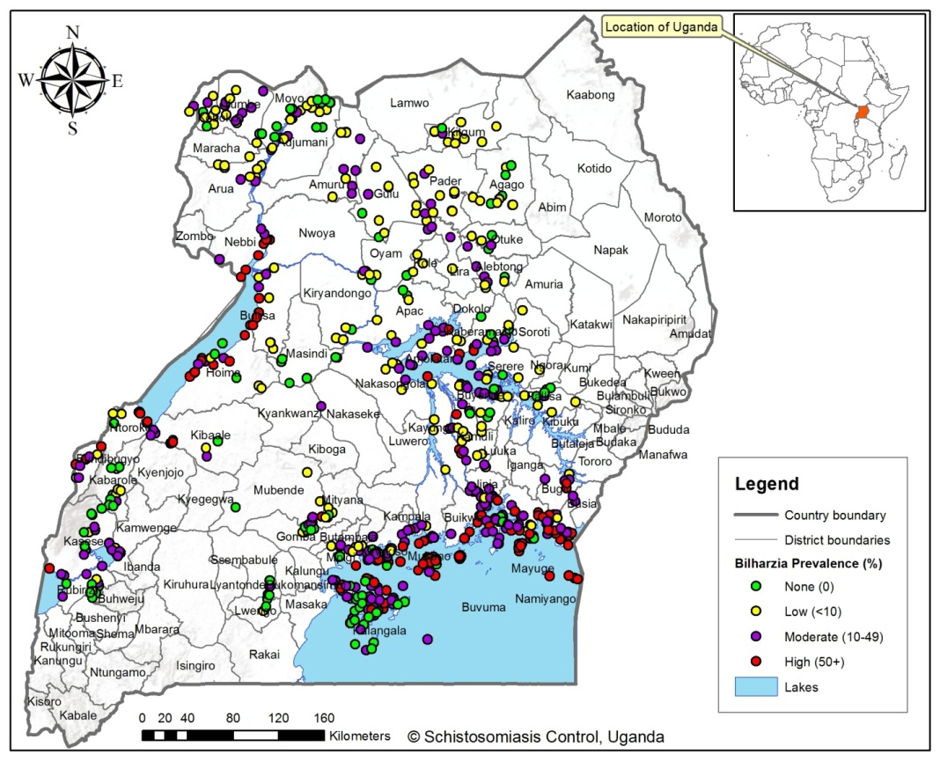
SCIENTIFIC GOALS
Focuses on reducing disease through periodic, large-scale population treatment with Praziquantel combined with Health Education.
Schistosomiasis in Uganda
Objectives:
Elimination of morbidity due to schistosomiasis to as a public health problem
Goals:
To implement MDA in 100% of districts implementing.
To achieve at least 75% therapeutic coverage during annual MDA in school-age children and high-risk communities.
To eliminate heavy intensity infections of schistosomiasis in school-age children and high-risk communities.
?

Slide 6
RESEARCH QUESTIONS
Main Research Questions for BWCP
Project Research Questions
What is the best way to monitor schistosome infections and drug efficacy?
Has drug resistance been selected for?
What is the potential for the spread of drug resistance?
What other factors drive transmission?
Is a standardized multi-parallel-PCR assay more sensitive diagnostic tool for detecting STH and Schistosoma mansoni prevalence compared to the Kato-Katz stool test in the face of elimination stage after MDA stoppage for LF?
What is efficacy of MEBZ and ALB against STH after several years of MDA?
What factors affecting Praziquantel uptake in endemic districts in Uganda
What is the level of available WASH activities in relation to control and prevention of schisto and STH in endemic districts.
How best can a schisto programme targeting school age children sufficiently reach the non-enrolled children.
What factors affecting proper and timely reporting of SAEs
What is the level of community awareness about schistosomiasis and STH transmission, prevention and control

Slide 7
SCHEMATIC ORGANIZATION OF FIELD SURVEYS IN UGANDA
Opportunities/ Capacities for collaboration
Personnel
Senior Technical Staffs
Junior Staffs
District Program coordinators.
Village Health Teams
Equipments
Microscopes
Freezers for sample storage
PCR Machine
Elizer plate reader
HB Photometers
Haematology Analyzer Machine
Office Space
Laboratory Space
Vehicles for field Activities.
Research Collaborations Skills
Molecular studies on Helminths.
Parasitology work on Helminths
Immunology of Helminthes .
Medical Malacology
conducts prior survey sensitisation & marshalling
Participants
exits &
returns day 2
later records subsequent malaria treatments in community
MOH Technician
MOH Technician
District Technician
?
4
Local CDD
1
2
3
registration/
height and weight
fingerpricking
/RDT/Hb/serology
questionnaire
clinical examination/
treatment
Stool & serological analysis
8
5
6
7
2x centrifuge
ELISA plate reader
Cooler
Generator
Kato-Katz
preparations
Microscopy
(KK, malaria and Flotac)
parasite egg collection on FTA cards
ELISAs,
FOB and CCA
Freezer
(-20C)

Slide 8
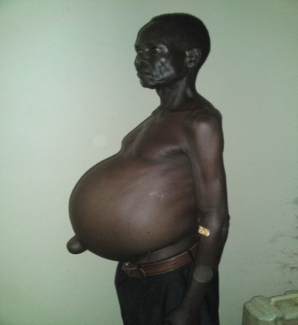
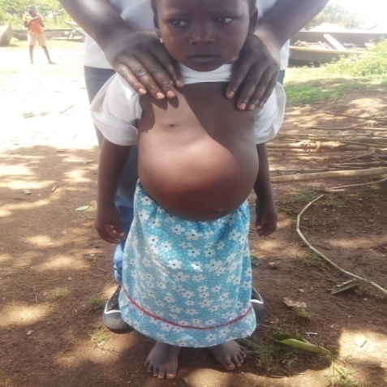
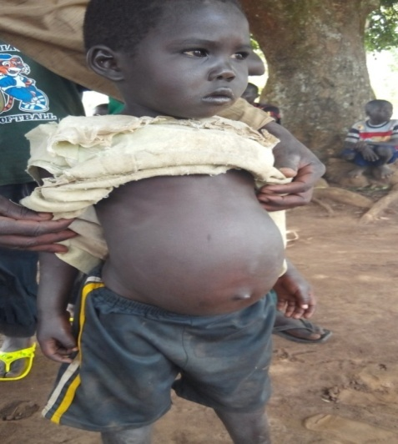
CHALLENGES FOR RESERARCH IN UGANDA
Lack of resources for in-country technical capacity building and support operational research for schisto.
Lack of resources to collect Sanitation-related indicators (Hand washing, measuring faecal contamination of environments).
High Operational Costs in the Hard-to-reach Areas (Islands).
Poor Latrine/ toilet coverage in all landing sites & Islands –(Contribute to high re-infections).
Missing Link with WASH partners on schisto.
Morbidity due to Bilharzia

Slide 9
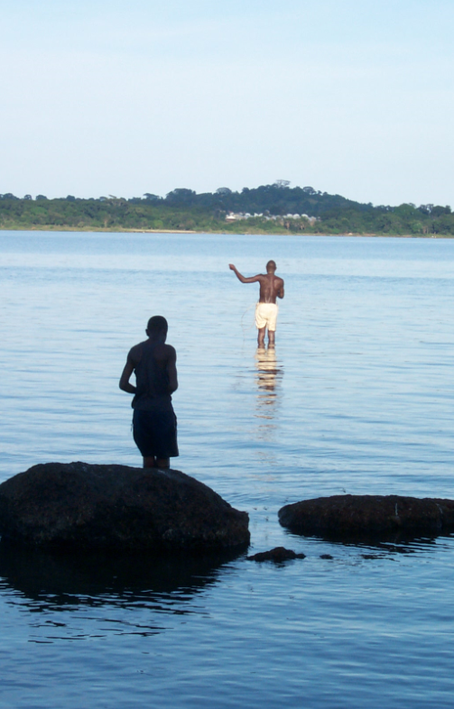
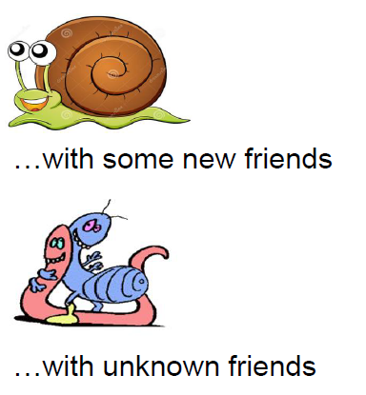
ACKNOWLEDGEMENTS
MeBOP Course Coordinators
Welcome Trust
University of Bern
University of Glasgow
LSTM
LSHTM
University of Cambridge
MeBOP Course Colleagues
To many other friends & long-term colleagues in
Schistosomiasis control research
Snail-borne diseases

